Slide 1


AnaPico Products
For Quantum Computing
Yu Gao, VP Sales
Quantum X, Get-to-know Meeting,
KIT NanoMat, Germany
Jan. 24, 2022

Slide 2


AnaPico AG Switzerland www.anapico.com
100% Swiss Company
Supplying RF and MW Test Instruments
Represented in over 40 countries
ISO 9001 certified
Founded in 2004 in Zurich, Switzerland
Privately held
R&D, manufacture, sales and marketing
Profitable and growing since > 10 consecutive years
© AnaPico AG, Switzerland
2

Slide 3
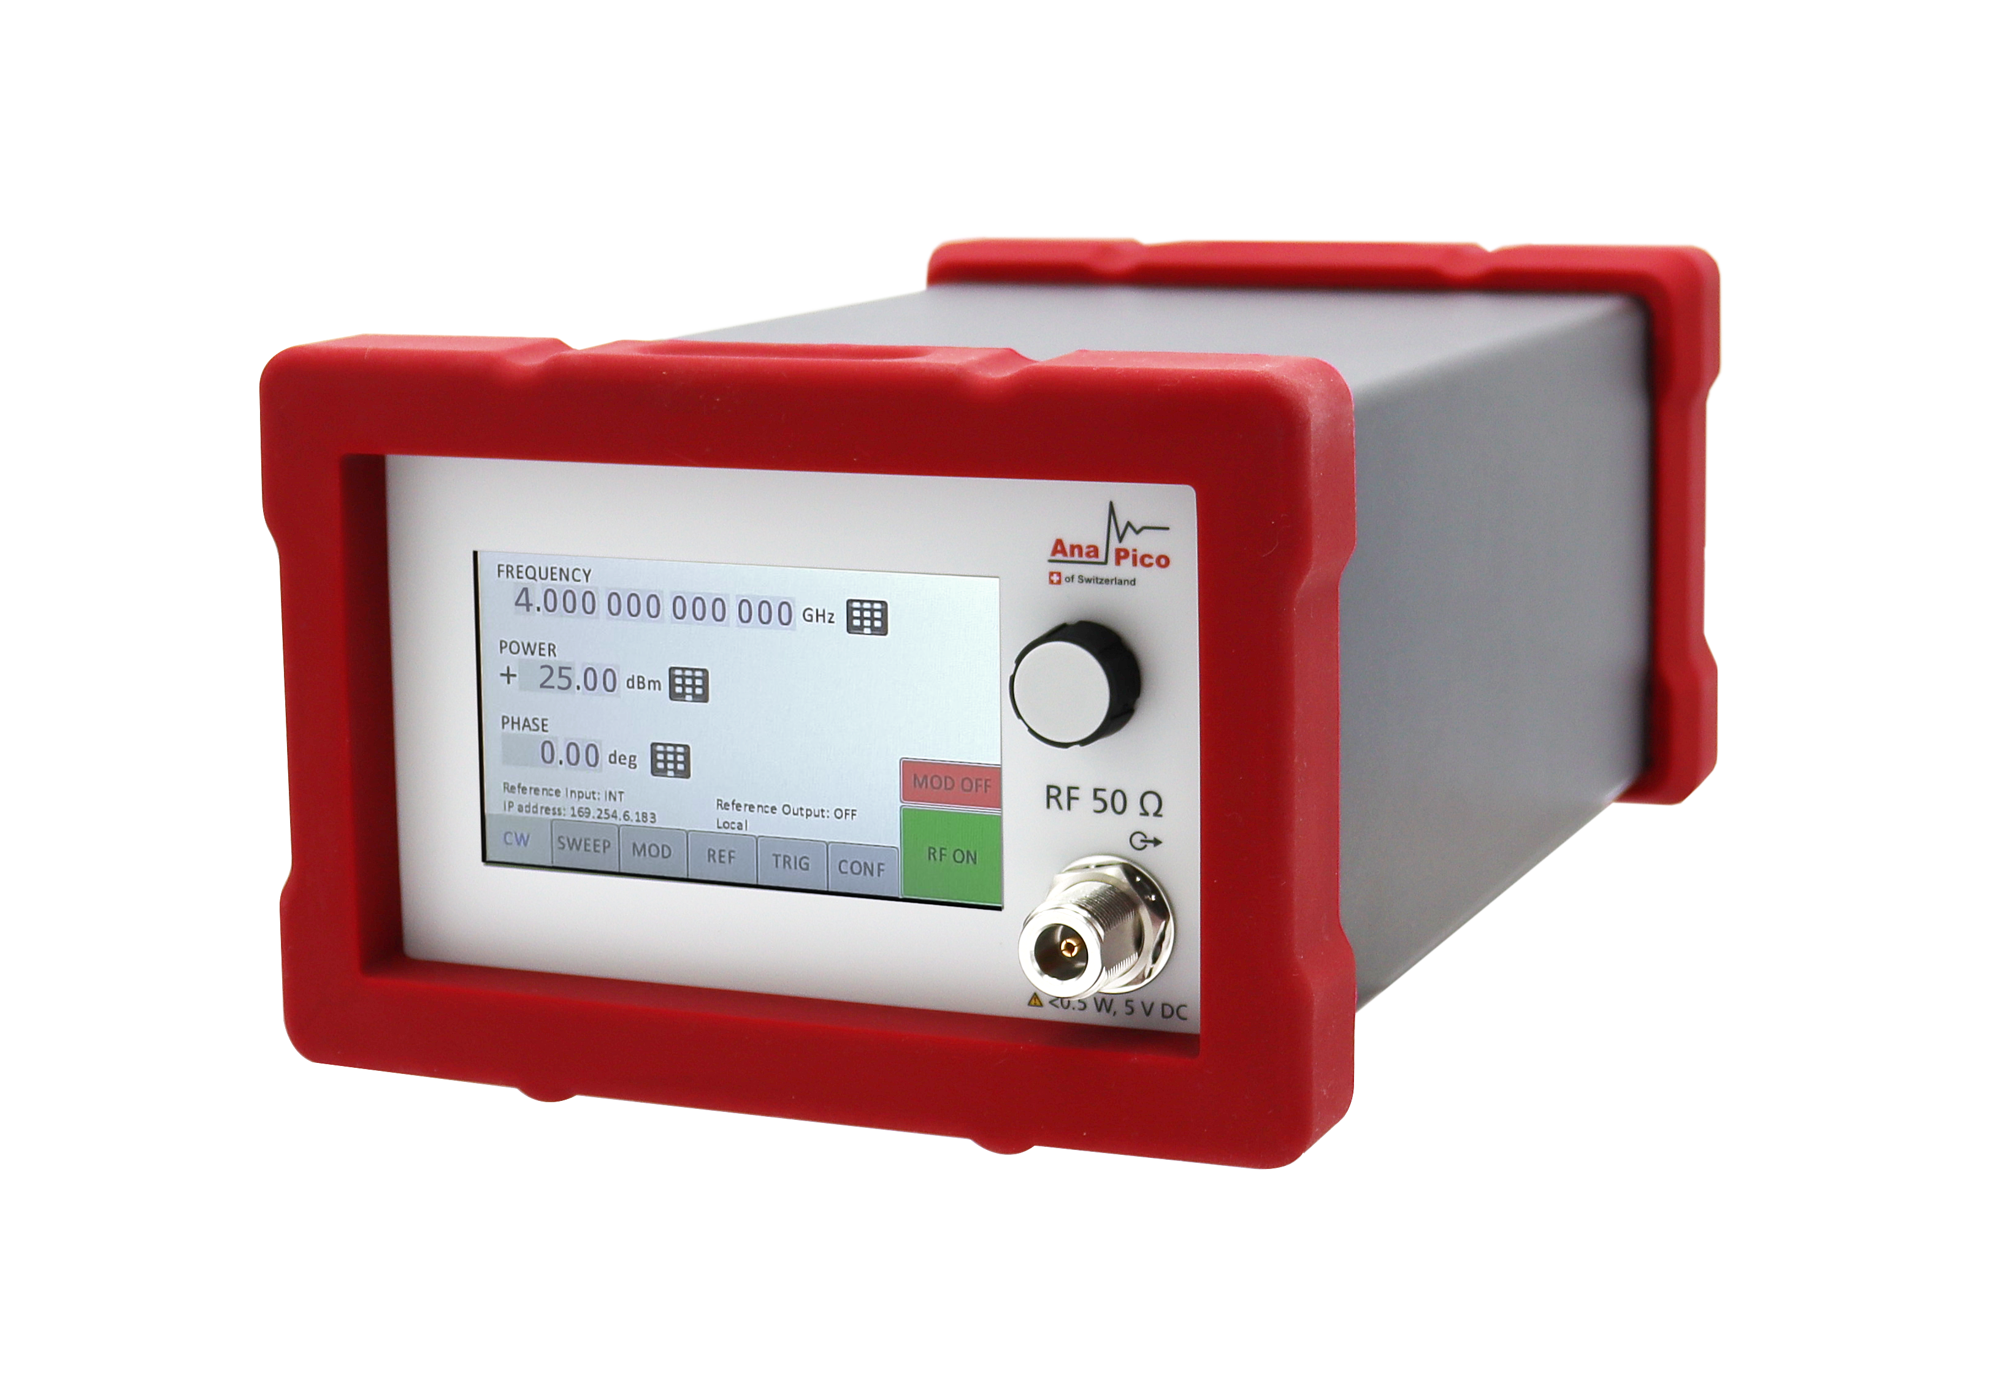
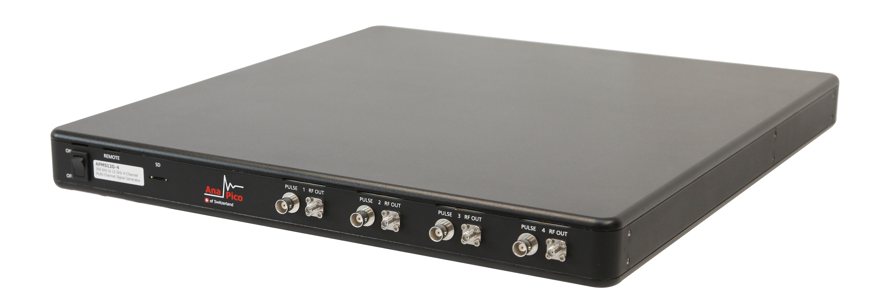
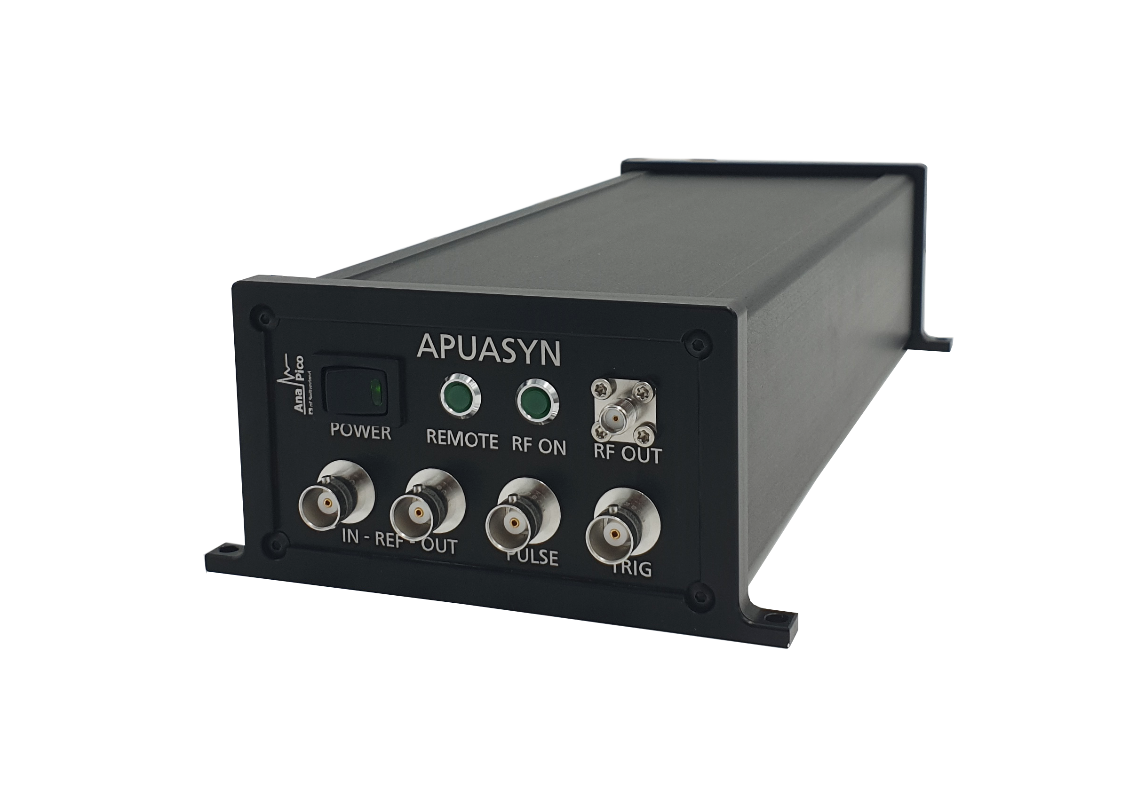
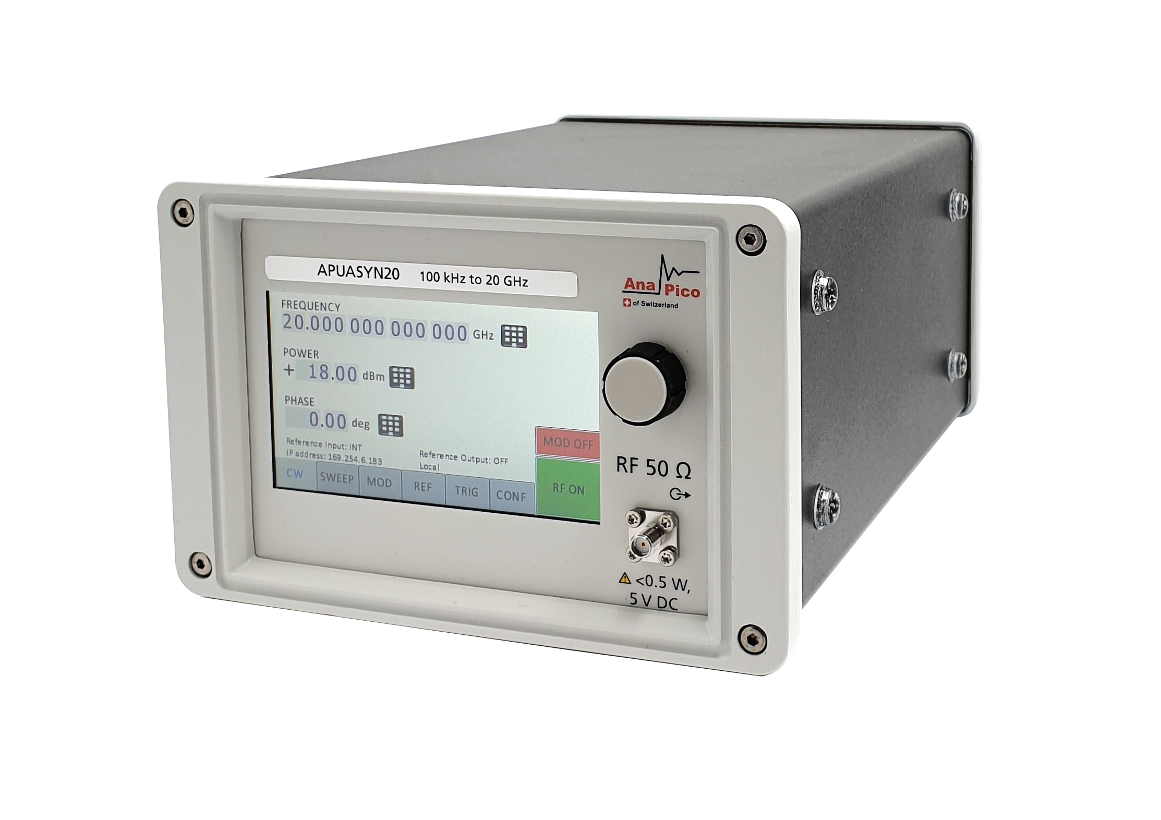
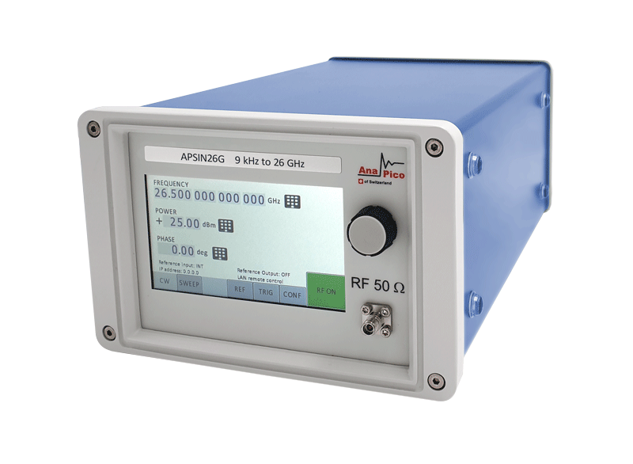
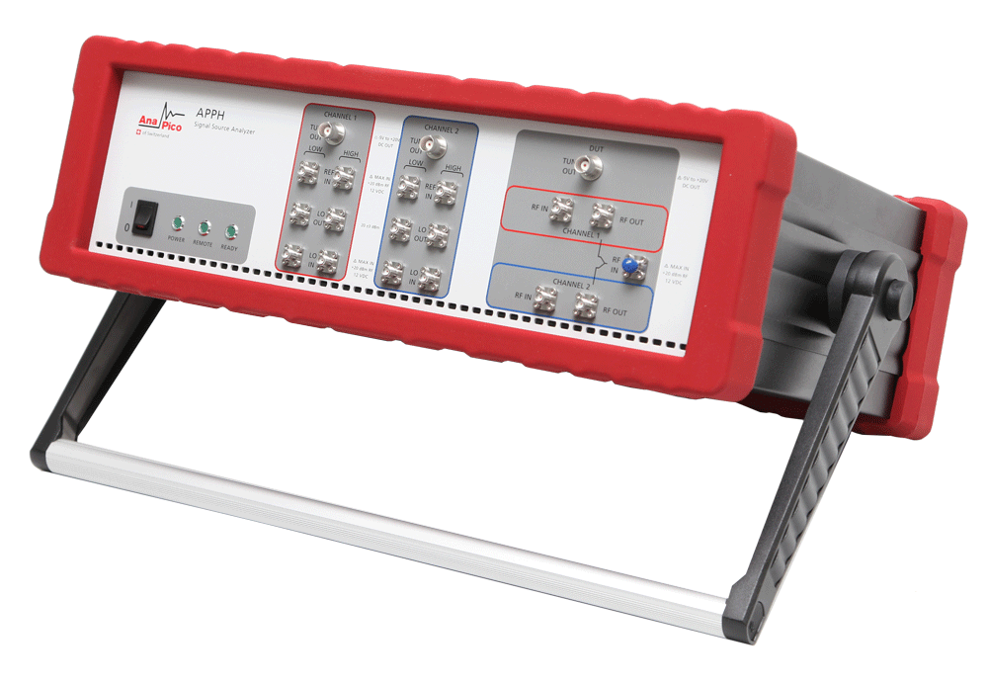
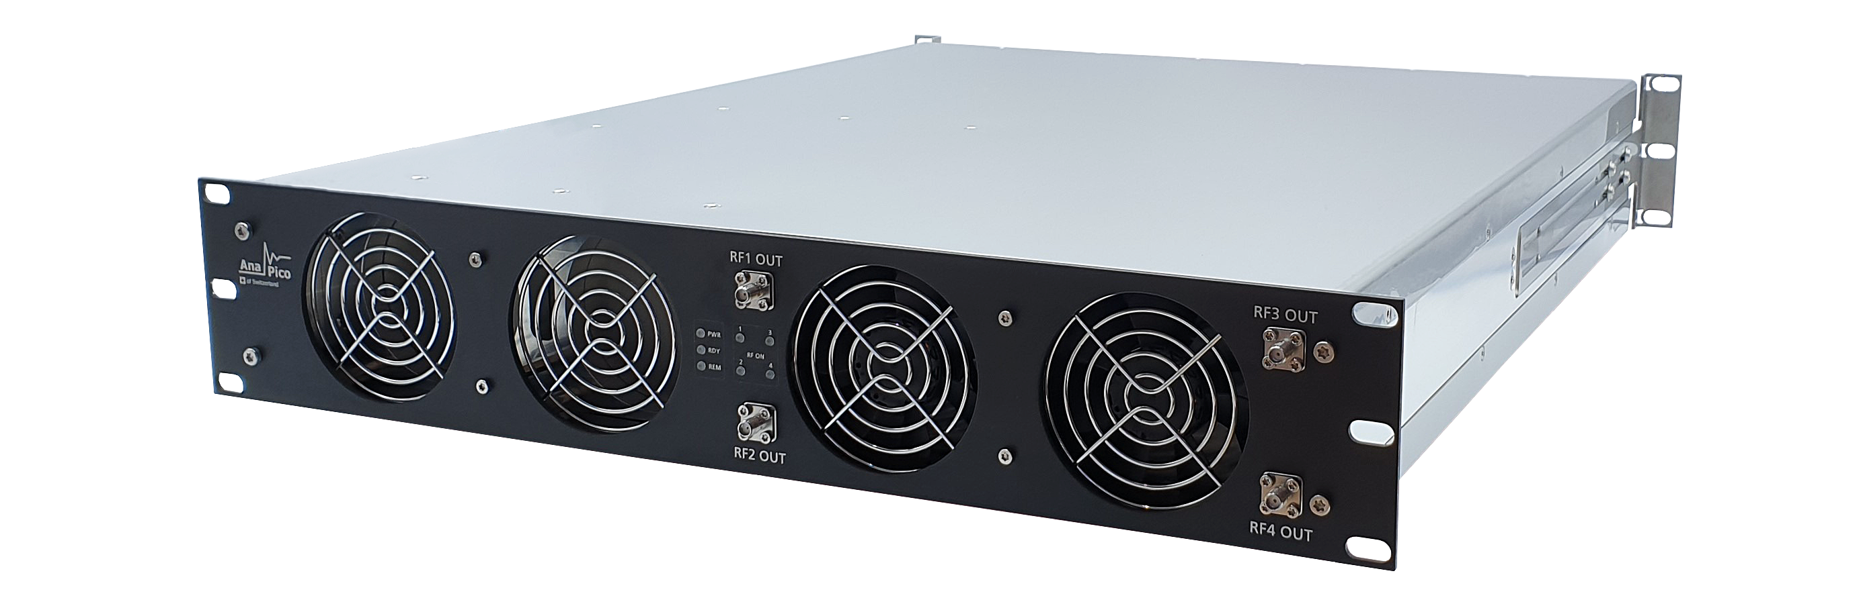
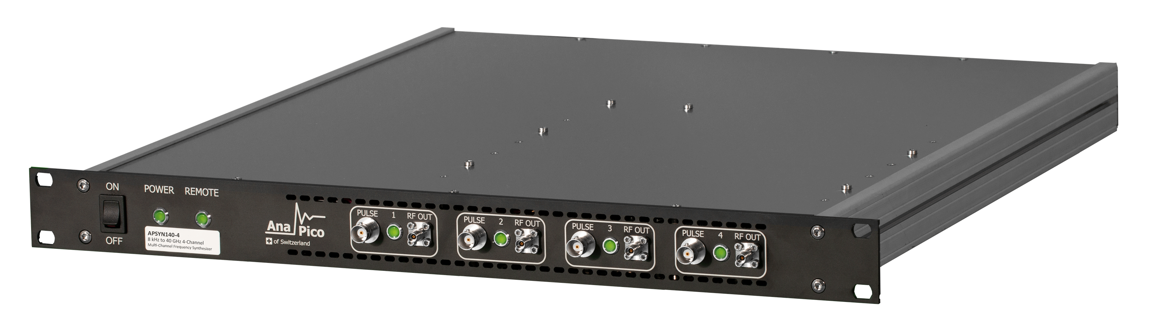
AnaPico Products
SINGLE-CHANNEL RF / MW SIGNAL GENERATORS | MULTI-CHANNEL RF / MW SIGNAL GENERATORS | FREQUENCY SYNTHESIZERS SINGLE- / MULTI-CHANNELS | SIGNAL SOURCE ANALYZERS / PHASE NOISE TESTERS
APSINX010: single-channel RF SG up to 2, 4, 6 GHz, analog modulations APSINXXG: single-channel MW SG up to 12, 20, 26 GHz, analog modulations APULN: high-performance RF and MW SG up to 6, 12, 20, 26, 40 GHz, analog modulations APVSG: ultra-agile, vector RF and MW SG up to 4, 6, 12, 20, 40 GHz, digital modulations | APMS-X: up to 4 fully independently adjustable, phase-coherent and phase memory, up to 6, 12, 20, 33, 40 GHz APVSG-X: up to 4 fully independently adjustable, phase-coherent, 4, 6, 12, 20, 40 GHz | APSYN420, APSYN140(-X): single- and multi-channel frequency synthesizers up to 20, 40 GHz APUASYN20(-X): ultra-compact up to 20 GHz, 1/2/3/4 channels | APPH: versatile, broadband instruments up to 7, 26, 40, 50, 65 GHz with very high measurement sensitivity

Slide 4
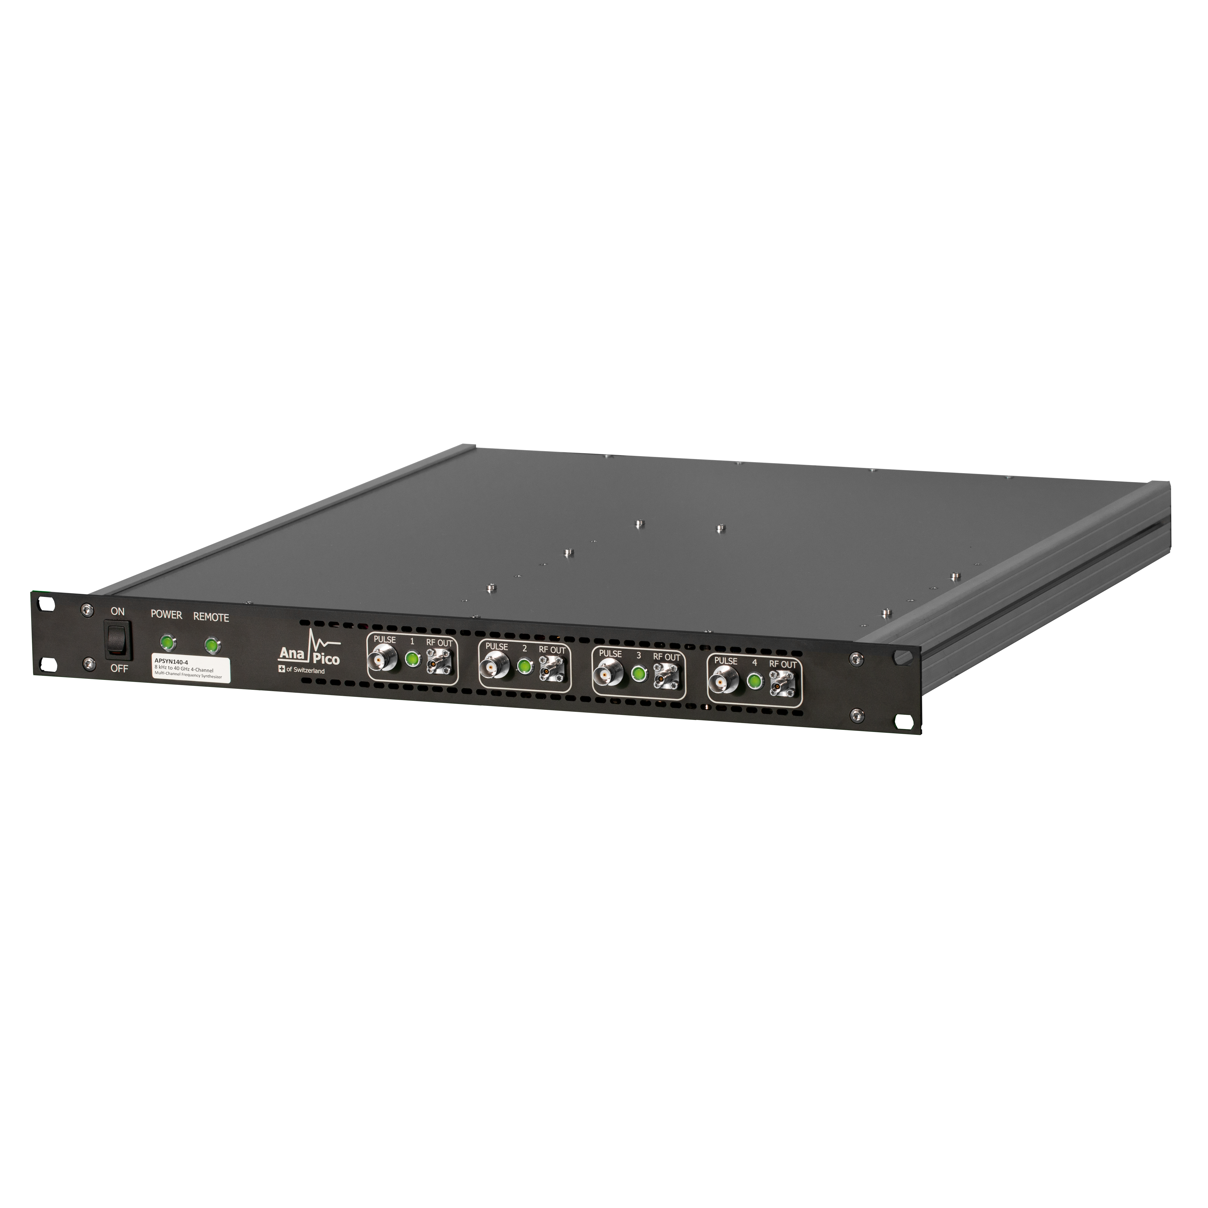
Multi-Channel MW Analog Sources
Models:
APMS-X: 6, 12, 20, 33, 40 GHz
APUASYN20-X: 20 GHz
APSYN140-X: 40 GHz
Main QC relevant features:
Settling time as quick as 5 to 25 us
Very low phase noise: 20 GHz, 10 Hz offset: -80 dBc/Hz; 100 kHz offset: -122 dBc/Hz
Output power: up to +25 dBm
Best-in-class phase coherence: RMS 0.2 degree@ 5 GHz over 5 hours
Unique phase-coherent switching: maintaining the same phase difference between the channels after frequency change and ON/OFF
Channel individual phase adjustment
Compact design: up to 4 channels in 1 HU RM module
Low power consumption: 15 to 40 W per channel
Powerful channel to channel synchronization: inter-channel sync and sync to external ref sources
Pulse modulation, AM/FM/PM.
Applications:
As RFLOs to IQ modulators / mixers
As pumping sources for parametric amplifiers

Slide 5
Multi-Channel MW Digital Sources
Models:
APVSG-X: 4, 6, 12, 20, 40 GHz
Main QC relevant features:
Settling time as quick as 200 ns
Very low phase noise: 20 GHz, 10 Hz offset: -80 dBc/Hz; 100 kHz offset: -120 dBc/Hz
Output power: up to +20 dBm
Best-in-class phase coherence: RMS 0.2 degree@ 5 GHz over 5 hours
Channel-individual phase adjustment
Compact design: up to 4 channels in 2 HU RM module
Low power consumption: 40 - 60 W per channel
Pulse, analog and vector modulations with bandwidth 400 MHz
Int. RAM 512 MSa per channel and ext. SD card for IQ waveform storage
Int. programmable and ext. controllable waveform selection and playback
Applications:
As RFLOs to IQ modulators / mixers
Generation of QuBit manipulation signals

Slide 6
APVSG for Quantum Computing
APVSG for QuBit Manipulation
Prestored Pulse-
Shaping IQ Data
Memory
IQ Mod.
Upconv.
AWG
CUSTOM FPGA
& CONTROL SW
Pulse-Shaping
IQ Data Stream
FCP
FRIDGE
Trigger &
Segment
Selection
LO
QuBit Readout (Customizable)
IQ Mix.
Digitizer
LO

Slide 7

Quantum Computing
Customer References
USA:
  IBM / Google / MIT / … USA
Europe:
  Oxford Uni. / Oxford Quantum Circuits / … UK
  Chalmers Uni., Sweden
  QuTech, Netherlands
  Uni. of Vienna, Austria
  KIT / TUM / FZJ / … Germany
  EPFL, MiraEx, Switzerland
Asia-Pacific:
  Qinghua Uni. / Beijing Uni. / Zhejiang Uni./ CAS / USTC / … China
  Tokyo Uni. / Nagoya Uni. / NTT / AIST / RIKEN / NICT / … Japan
  ETRI / KAIST, Korea
  Sydney Uni., Australia
© AnaPico AG, Switzerland
7

Slide 8

Contact AnaPico
AnaPico AG
Europa-Strasse 9
8152 Glattbrugg
Switzerland
Phone: +41 44 440 00 50
General information: info@anapico.com
Sales: sales@anapico.com
Support: support@anapico.com
Marketing: marketing@anapico.com
© AnaPico AG, Switzerland
8

